Slide 2
Where in the west metro (Hopkins, Wayzata, St Louis Park) should you live?
Pick 3 schools to visit for your 5 year old, who will start kindergarten next fall. Then learn when visits are, how they work.
Use the state’s school report card web page (https://rc.education.state.mn.us/) and any other on-line resource you can find

Slide 4
You just bought a house at 44 Oliver St in Minneapolis (55405). Congratulations!
Pick 3 middle schools to visit for your 10 year old, who will start 6th grade next fall. Then learn when visits are and how they work.
Use the city’s school choice web page (http://schoolchoice.mpls.k12.mn.us/) and any other on-line resource you can find

Slide 5
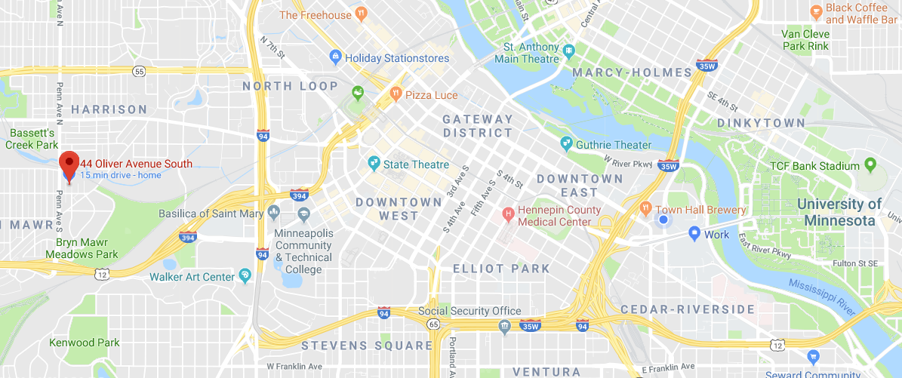

Slide 8
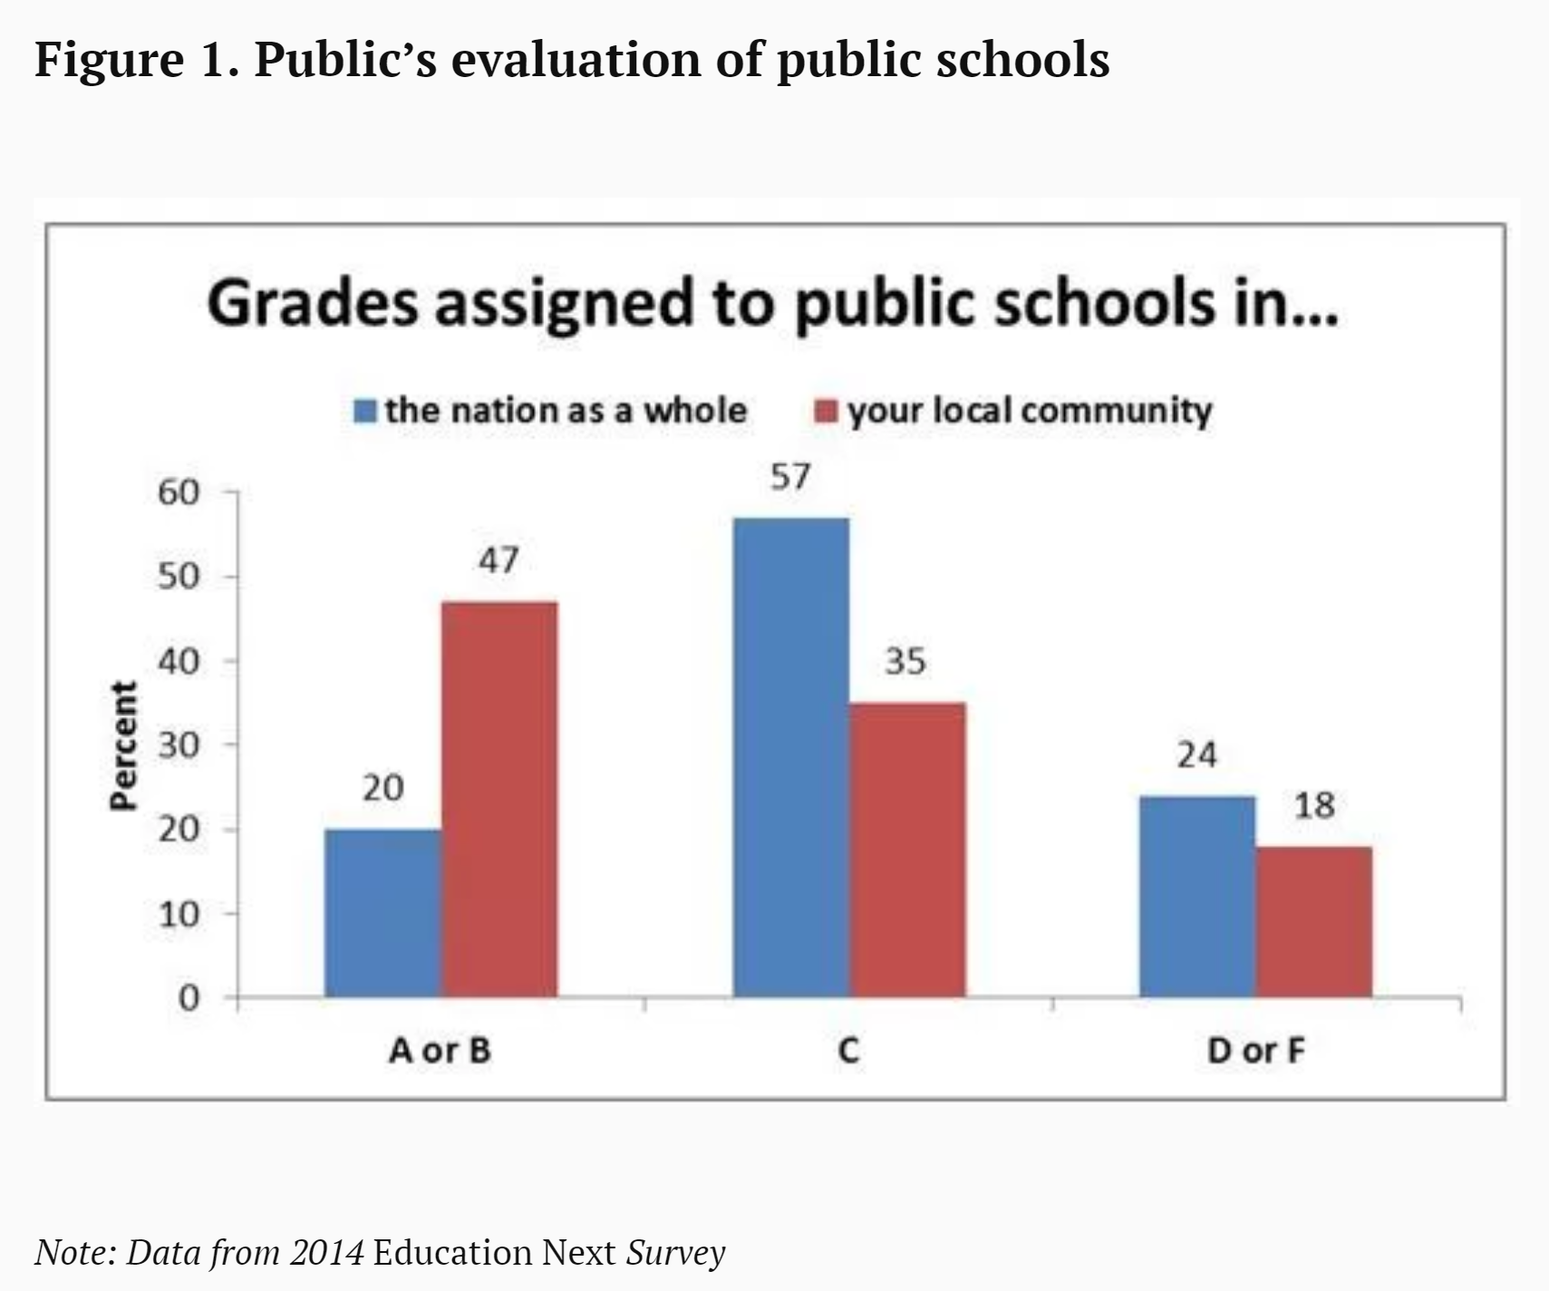

Slide 10
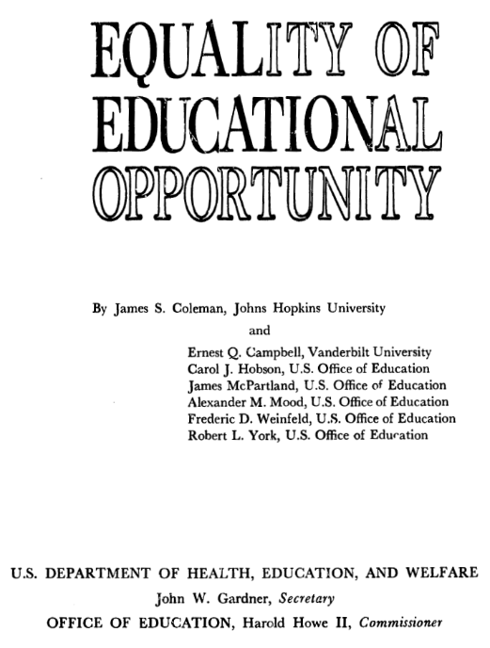
Coleman Report
Notes:
The Coleman Report was mandated by the Civil Rights Act of 1964. The act gave the U.S. Office of Education two years to produce a report that was expected to describe the inequality of educational opportunities in elementary and secondary education across the United States.
Working quickly as soon as the Civil Rights Act was signed into law, the Coleman research team drew a sample of over 4,000 schools, which yielded data on slightly more than 3,000 schools and some 600,000 students in grades 1, 3, 6, 9, and 12. The team asked students, teachers, principals, and superintendents at these schools a wide range of questions. The study broadened the measures of school quality beyond what policymakers envisioned. The surveys gathered objective information about “inputs,” but they also asked about teacher and administrative attitudes and other subjective indicators of quality. The most novel aspect of the study was the assessment of students, who were given a battery of tests of both ability and achievement.
To be clear, Coleman did find huge inequalities: For example, in 1965, Coleman tells us, the average black 12th grader in the rural South registered an achievement level that was comparable to that of a white 7th grader in the urban Northeast.
Summary: “Taking all these results together, one implication stands out above all: That schools bring little influence to bear on a child’s achievement that is independent of his background and general social context; and that this very lack of an independent effect means that the inequalities imposed on children by their home, neighborhood, and peer environment are carried along to become the inequalities with which they confront adult life at the end of school.”
Lazy reading: School funding has little effect on student achievement. Schools don’t matter.
More nuanced reading: Academic achievement is less related to the quality of a student's school or teachers, and more related to the social composition of the school and the student's family background
Other important findings:
African American students benefit from schooling in non-segregated classrooms. … this was a catalyst for the implementation of the desegregation of busing systems. (In 1975 he wrote another report showing that busing had failed to achieve its goals because of “white flight” He was nearly expelled from ASA)

Slide 11
“Taking all these results together, one implication stands out above all: That schools bring little influence to bear on a child’s achievement that is independent of his background and general social context; and that this very lack of an independent effect means that the inequalities imposed on children by their home, neighborhood, and peer environment are carried along to become the inequalities with which they confront adult life at the end of school.”
Notes:
The Coleman Report was mandated by the Civil Rights Act of 1964. The act gave the U.S. Office of Education two years to produce a report that was expected to describe the inequality of educational opportunities in elementary and secondary education across the United States.
Working quickly as soon as the Civil Rights Act was signed into law, the Coleman research team drew a sample of over 4,000 schools, which yielded data on slightly more than 3,000 schools and some 600,000 students in grades 1, 3, 6, 9, and 12. The team asked students, teachers, principals, and superintendents at these schools a wide range of questions. The study broadened the measures of school quality beyond what policymakers envisioned. The surveys gathered objective information about “inputs,” but they also asked about teacher and administrative attitudes and other subjective indicators of quality. The most novel aspect of the study was the assessment of students, who were given a battery of tests of both ability and achievement.
To be clear, Coleman did find huge inequalities: For example, in 1965, Coleman tells us, the average black 12th grader in the rural South registered an achievement level that was comparable to that of a white 7th grader in the urban Northeast.
Summary: “Taking all these results together, one implication stands out above all: That schools bring little influence to bear on a child’s achievement that is independent of his background and general social context; and that this very lack of an independent effect means that the inequalities imposed on children by their home, neighborhood, and peer environment are carried along to become the inequalities with which they confront adult life at the end of school.”
Lazy reading: School funding has little effect on student achievement. Schools don’t matter.
More nuanced reading: Academic achievement is less related to the quality of a student's school or teachers, and more related to the social composition of the school and the student's family background
Other important findings:
African American students benefit from schooling in non-segregated classrooms. … this was a catalyst for the implementation of the desegregation of busing systems. (In 1975 he wrote another report showing that busing had failed to achieve its goals because of “white flight” He was nearly expelled from ASA)

Slide 12
Distribution of Math Test Scores of Sophomores,
One High School
75th Percentile
Median
25th Percentile
Source: 1980 High School and Beyond. Test is sophomore math formula score. Figure excludes schools with fewer than 30 sophomores. Each bar depicts the 25th, 50th, and 75th percentiles of the test score distribution.

Slide 13
Distribution of Math Test Scores of Sophomores,
by High School
Source: 1980 High School and Beyond. Test is sophomore math formula score. Figure excludes schools with fewer than 30 sophomores. Each bar depicts the 25th, 50th, and 75th percentiles of the test score distribution.

