Slide 2
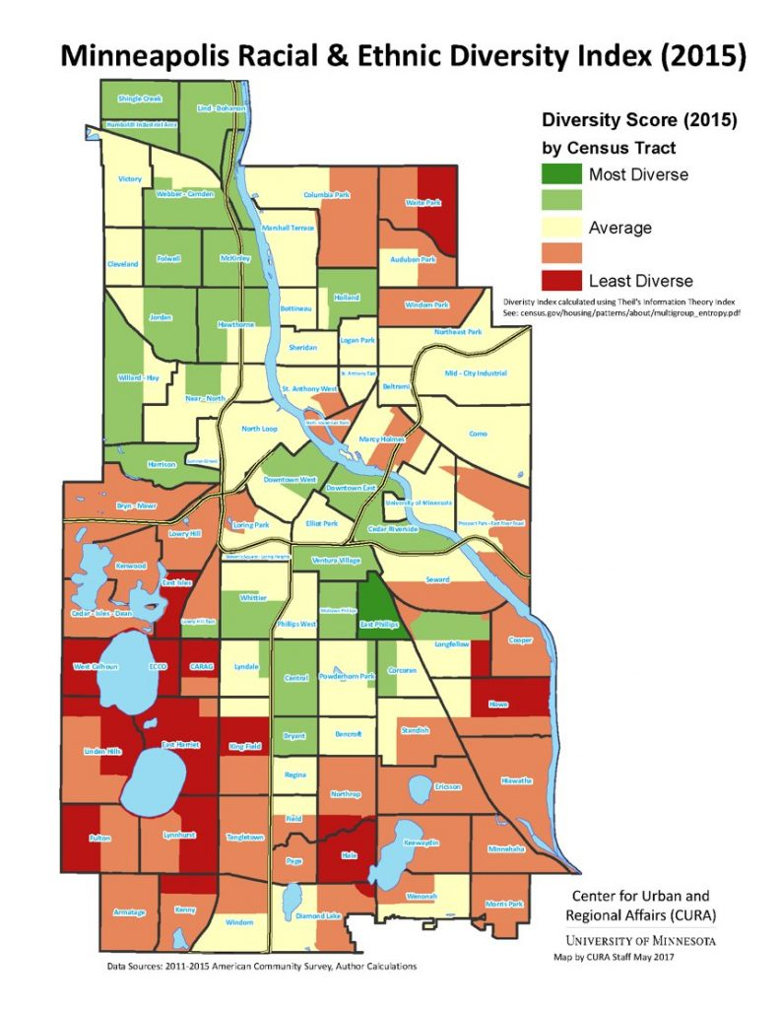
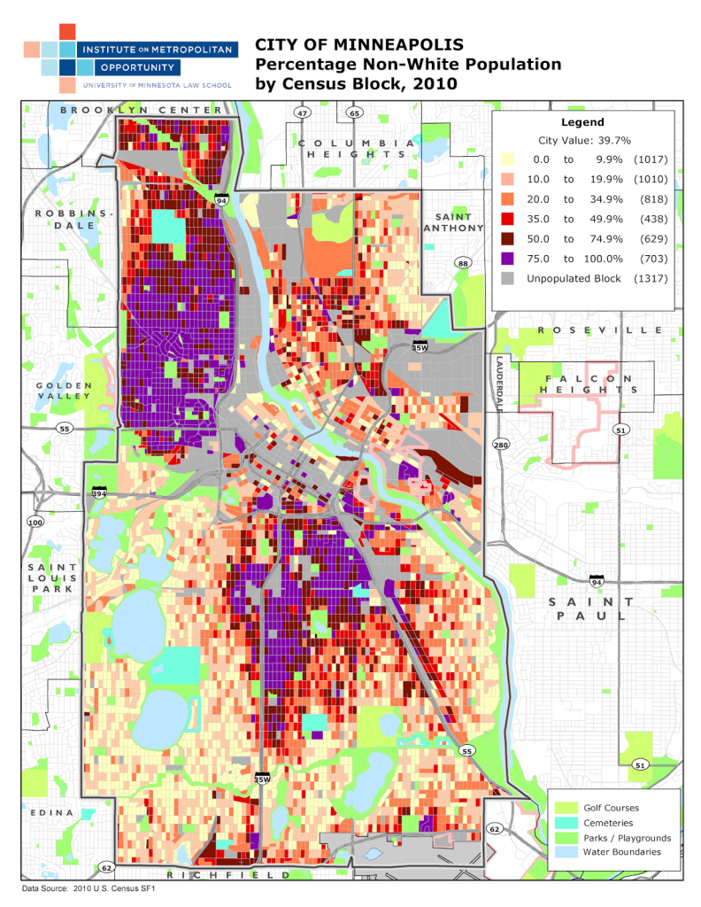

Slide 3
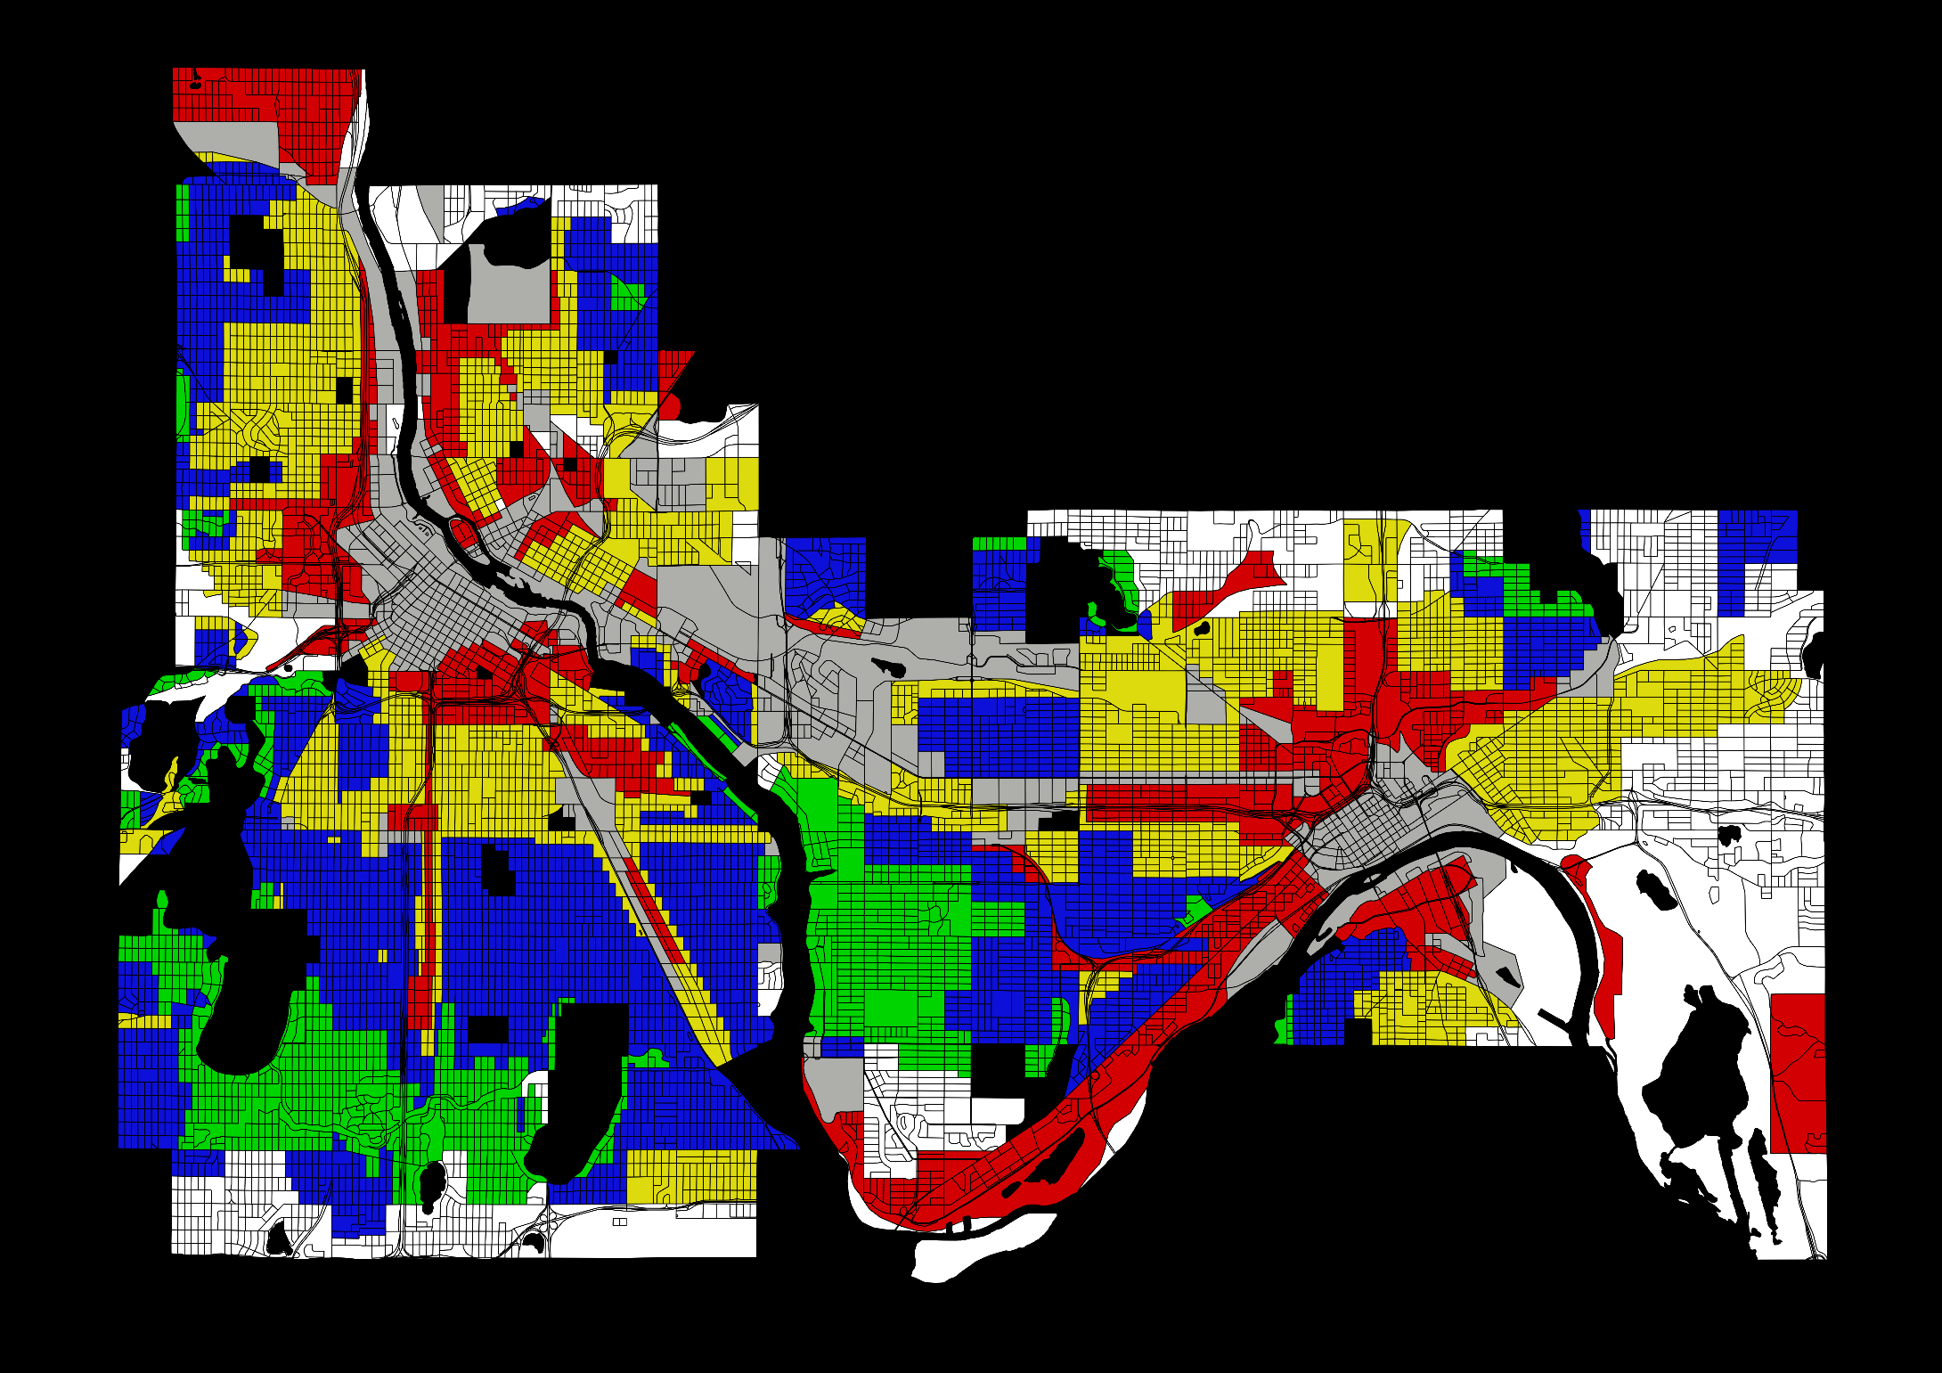
Federal Housing Administration's
Home Owners’ Loan Corporation
1934 Red Lining Map

Slide 4
Federal Housing Administration's
Home Owners’ Loan Corporation
1934 Red Lining Map

Slide 6
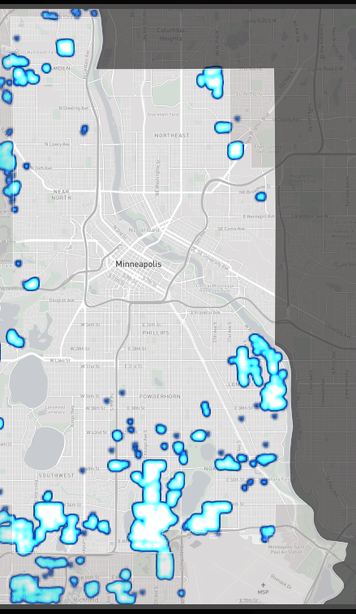
Racial Covenants in Minneapolis, 1955
From “Mapping Prejudice” project at
The Borchert Library

Slide 7
Racial Covenants in Minneapolis, 1955
From “Mapping Prejudice” project at
The Borchert Library

Slide 8
Racial Covenants in Minneapolis, 1955
From “Mapping Prejudice” project at
The Borchert Library

Slide 13
Racial Composition of Minneapolis High Schools, 2015-16
(In each high school, this is percentage of students who belong to each group)

Slide 15
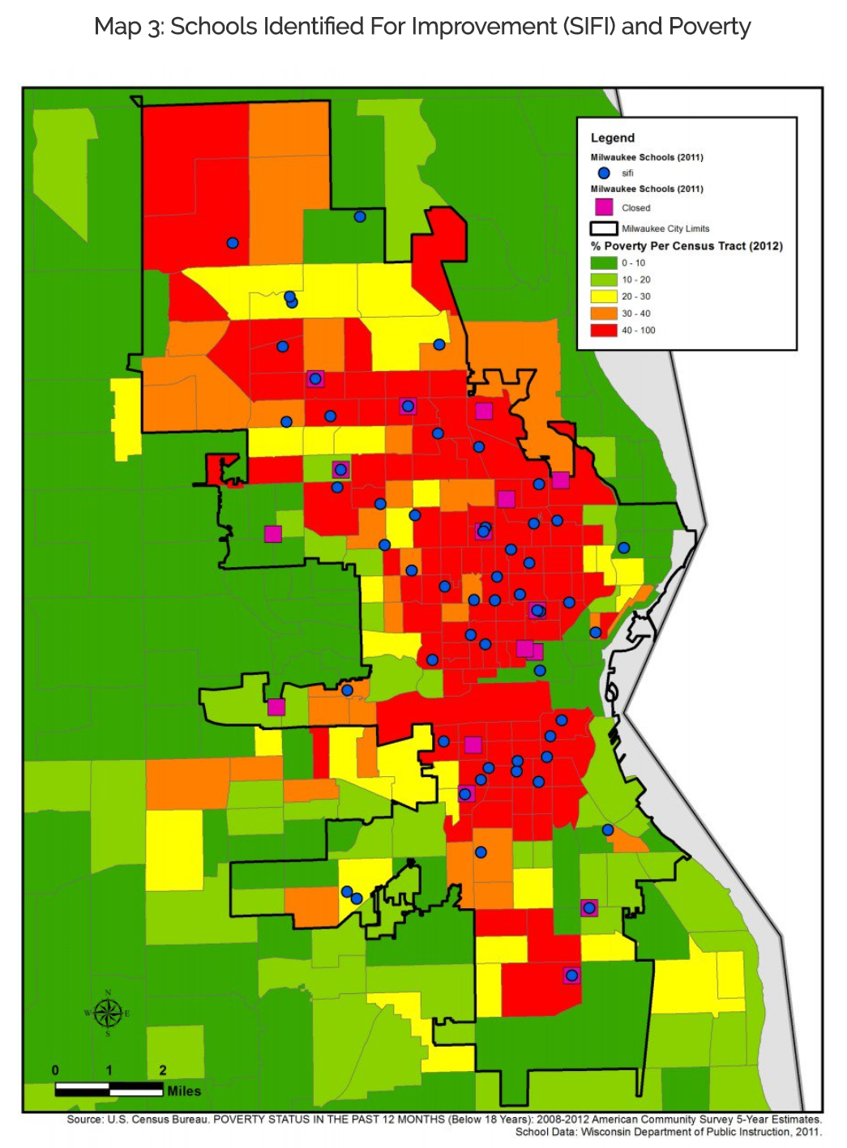

Slide 16
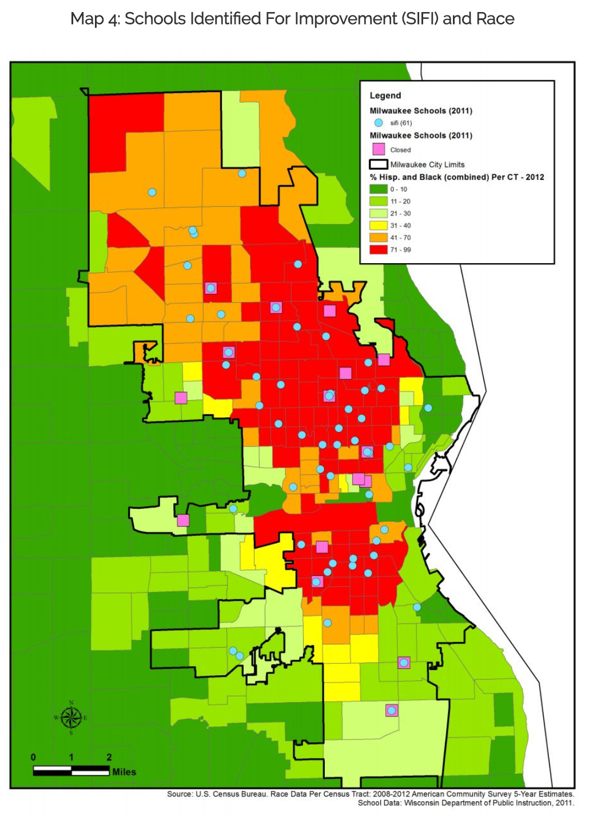

Slide 19
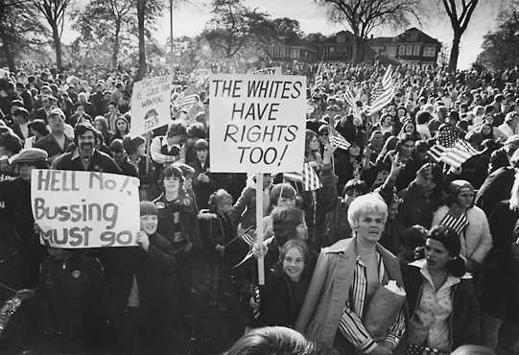
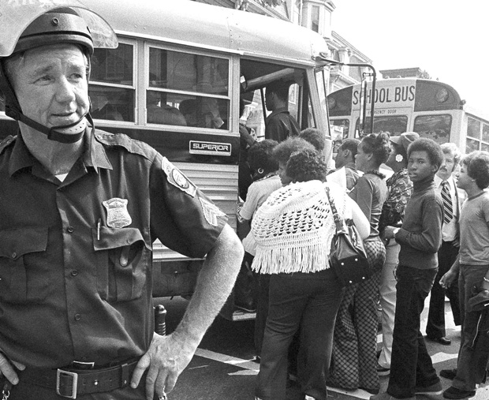

Slide 21
Local
State
Federal
SOURCE: U.S. Department of Education, National Center for Education Statistics, Biennial Survey of Education in the United States, 1919-20 through 1949-50; Statistics of State School Systems, 1959-60 and 1969-70; Revenues and Expenditures for Public Elementary and Secondary Education, 1979-80; and Common Core of Data (CCD), "National Public Education Financial Survey," 1989-90 through 2014-15. (This table was prepared October 2017.)

Slide 25
