Slide 2
“So that the record of history is absolutely crystal clear, that there is no alternative way so far discovered of improving the lot of the ordinary people that can hold a candle to the productive activities that are unleashed by the free-enterprise system.”
Milton Friedman, 1979

Slide 3
“Government, preferably local governmental units, would give each child, through his parents, a specified sum to be used solely in paying for his general education; the parents would be free to spend this sum at a school of their own choice, provided it met certain minimum standards laid down by the appropriate governmental unit.”
Milton Friedman, 1955

Slide 4
“Such schools would be conducted under a variety of auspices: by private enterprises operated for profit, non profit institutions established by private endowment, religious bodies, and some even by governmental units.”
Milton Friedman, 1955

Slide 5
“The educational foundations of our society are presently being eroded by a rising tide of mediocrity that threatens our very future as a Nation and a people.”
A Nation at Risk, 1983

Slide 6
“If an unfriendly foreign power had attempted to impose on America the mediocre educational performance that exists today, we might well have viewed it as an act of war.”
A Nation at Risk, 1983

Slide 7
School Choice
Arose in response to segregation, unequal opportunities, frustration with public schools
Basic idea: Allow teachers and local residents to innovate using public education dollars

Slide 8
Charter Schools
Public dollars fund independent schools
1st opened in 1992
Now in 43 states + D.C.

Slide 9
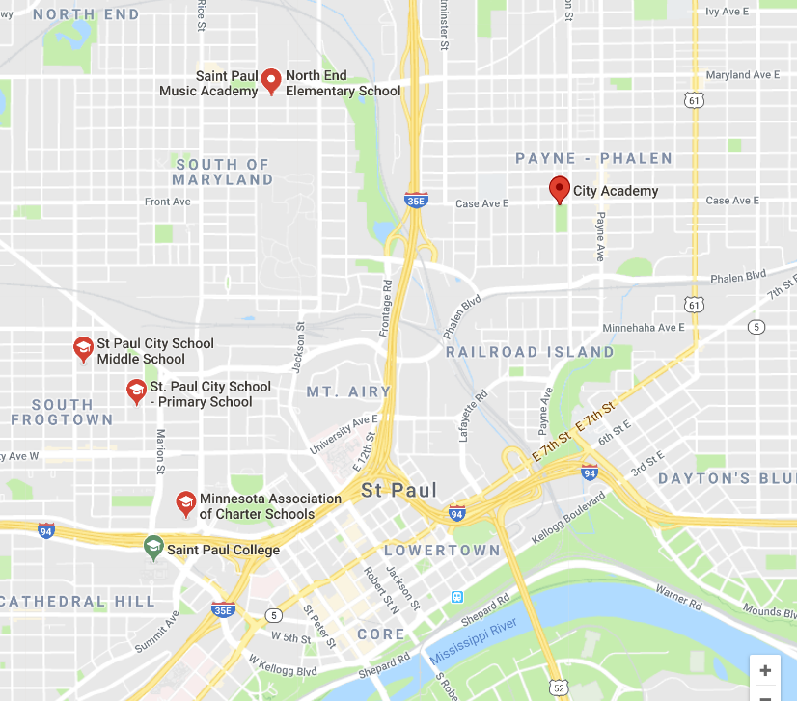

Slide 10
Voucher Programs
Public dollars parents can use to send their kids to private or religious schools
27 states

Slide 12
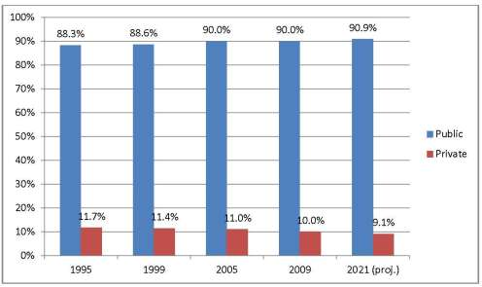
Private School Enrollments, 1995-2021
SOURCE: U.S. Department of Education, National Center for Education Statistics, Private School Universe Survey (PSS), biennial, 1999–2000 through 2015–16; Common Core of Data (CCD), "State Nonfiscal Survey of Public Elementary and Secondary Education," 1999-2000 through 2015-16. See Digest of Education Statistics 2016, tables 105.30 and 205.20; Digest of Education Statistics 2017, table 203.40.

Slide 13
Racial Composition of Minneapolis High Schools, 2015-16
(In each high school, this is percentage of students who belong to each group)

Slide 14
In FAVOR of Charter Schools
What problem --- especially with traditional public schools --- are charter programs designed to solve?
What are the advantages of charter school programs, especially in light of the logic of free markets and competition?
What are some ways in which charter schools are succeeding?
How do you counter arguments made by people opposed to charter schools?
How do charter school programs improve economic and racial inequalities in schooling?

Slide 15
AGAINST Charter Schools
What are the downsides of charter school programs, especially in light of their effects on traditional public schools?
How successful have charter school programs been in the United States?
How do you counter arguments made by people in favor of charter schools?
How do charter school programs exacerbate economic and racial inequalities in schooling?

Slide 16
In FAVOR of Voucher Programs
What problem --- especially with traditional public schools --- are voucher programs designed to solve?
What are the advantages of voucher programs, especially in light of the logic of free markets and competition?
What are some ways in which voucher programs are succeeding?
How do you counter arguments made by people opposed to voucher programs?
How do voucher programs improve economic and racial inequalities in schooling?

Slide 17
AGAINST Voucher Programs
What are the downsides of voucher programs, especially in light of their effects on traditional public schools?
How successful have voucher programs been in the United States?
How do you counter arguments made by people in favor of voucher programs?
How do voucher programs exacerbate economic and racial inequalities in schooling?

