Slide 2
Results Sections

Slide 3
Results Sections
Announce your findings!

Slide 5
Results Sections
Include the findings of your study ... and ONLY the findings of your study
Do NOT interpret!
Only dwell on results that are most relevant to the research questions

Slide 6
Results Sections
Organize it logically ... perhaps by research question
Present a result and then explain it, before presenting the next result then explaining it, and so on, then end with an overall synopsis

Slide 7
Results Sections
DON'T discuss or interpret your results!
DON'T report background information
DON'T ignore negative results
DON'T present confusing figures or tables
DO be factual and concise

Slide 8
Discussion Sections
Goal: Answer the questions you raised in your front end by using the results you collected during your research

Slide 9
Discussion Sections
https://wordvice.com/research-writing-tips-editing-manuscript-discussion/

Slide 10
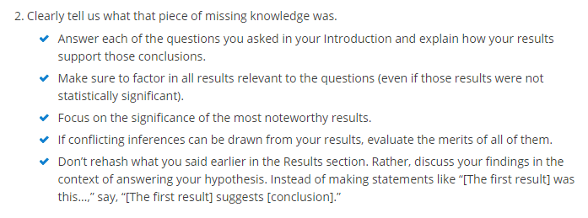
Discussion Sections
https://wordvice.com/research-writing-tips-editing-manuscript-discussion/

Slide 11
Discussion Sections
https://wordvice.com/research-writing-tips-editing-manuscript-discussion/

Slide 12
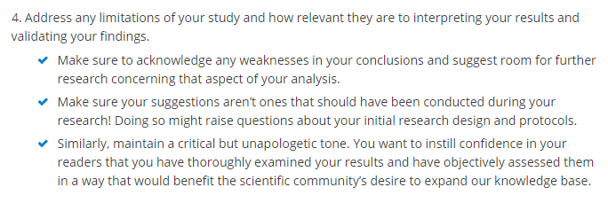
Discussion Sections
https://wordvice.com/research-writing-tips-editing-manuscript-discussion/

Slide 13
Discussion Sections
https://wordvice.com/research-writing-tips-editing-manuscript-discussion/

