Slide 2
Linking Results
0 to 10 year olds in the 1920 Census 25,241,189
…who are men 12,765,719
…and who are kids or step-kids of household head 12,498,173
…and who are fully linked to 1940 & death data 1,776,098
…and who have valid birth & death dates 1,776,076
…and who have 2+ linked boys in the household 359,732
N = 359,732 boys in 179,866 pairs

Slide 3
Methods Section
How will you answer the research questions?

Slide 4
Methods Section
Provide enough detail that someone could exactly replicate what you did

Slide 5
Methods Section
What data will you use (and why?)
How will you measure every concept?
What analytic methods will you use to answer each research question?
What problems do you anticipate and how will you overcome them?

Slide 6
Methods Section
What data will you use (and why?)
Name and describe the data source
How was the data collected?
How is the sample restricted?
Strengths/Weaknesses (vs. alternatives)
What would you say in your case?

Slide 7
Methods Section
How will you measure every concept?
Be precise!
Cover every concept in every question
Strengths/Weaknesses (vs. alternatives)
What about missing data?
What would you say in your case?

Slide 8
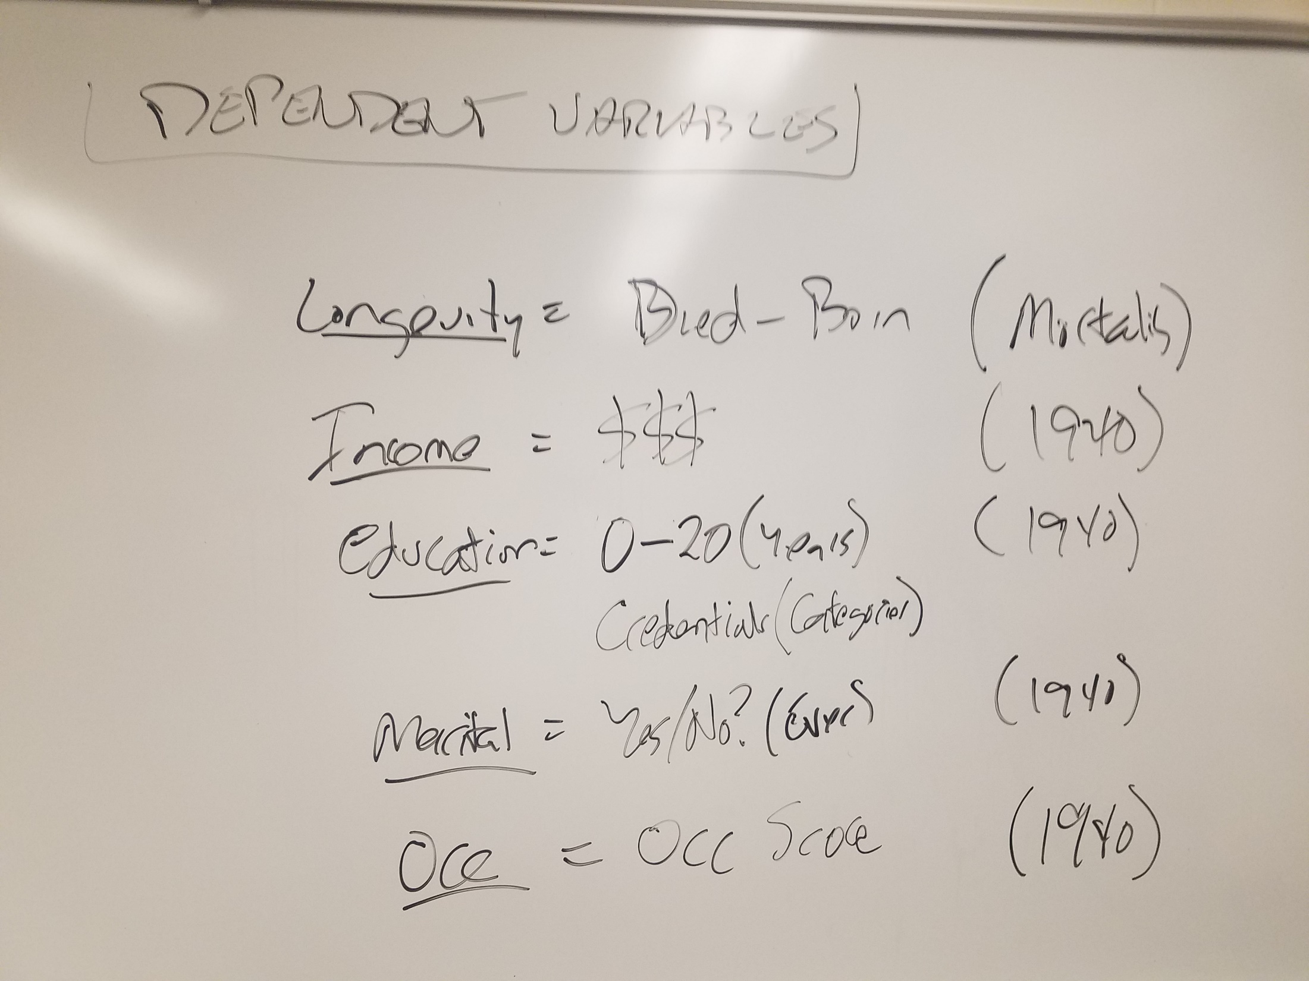

Slide 9
Methods Section
How will you measure every concept?
Be precise!
Cover every concept in every question
Strengths/Weaknesses (vs. alternatives)
What about missing data?
What would you say in your case?

Slide 10
Methods Section
What analytic methods will you use to answer each research question?
Go question by question
Start simple, get complex
Strengths/Weaknesses (vs. alternatives)
What would you say in your case?

Slide 11
Methods Section
What problems do you anticipate and how will you overcome them?
Outline threats to valid results
How will each be overcome?
What would you say in your case?

