Slide 1
Web Site?
Accessing Readings?
Canvas?
Syllabus/Course Questions?
Registration Issues?

Slide 2
Excited About…
Learning about research
Research experience
Getting practical skills
Working with data

Slide 3
Nervous About…
Lack of stats background
Lack of data analysis skills
Workload
Keeping up
Group work

Slide 5
Basic Structure of Research Articles
Abstract
Introduction / Background (aka, “Front End”)
Data / Methods
Results
Discussion
References

Slide 6
Get Context
Discipline?
Year?
Audience?

Slide 7
Know WHY You're Reading
Summarizing?
Finding out if the article is relevant?
Learning about theory or argument?
Learning about methods or data?
Learning about the basic findings?
Identifying OTHER relevant articles?

Slide 8
Skim It First
Basic structure?
Basic argument?
Basic findings?
What is new? What is important?
What is confusing?

Slide 9
Read Strategically & Surgically
Start with the abstract ... get the overview
Don't necessarily read the rest in order!
Depending on WHY you're reading, jump to relevant sections
Go back to other sections as needed

Slide 10
Where to Start (after the abstract)
Is it relevant? ... stop at the abstract
Theory or argument? ... read front end
Methods or data? ... read data/methods
Basic findings? ... read discussion
Finding OTHER relevant articles? ... read the front end and mine the references

Slide 12
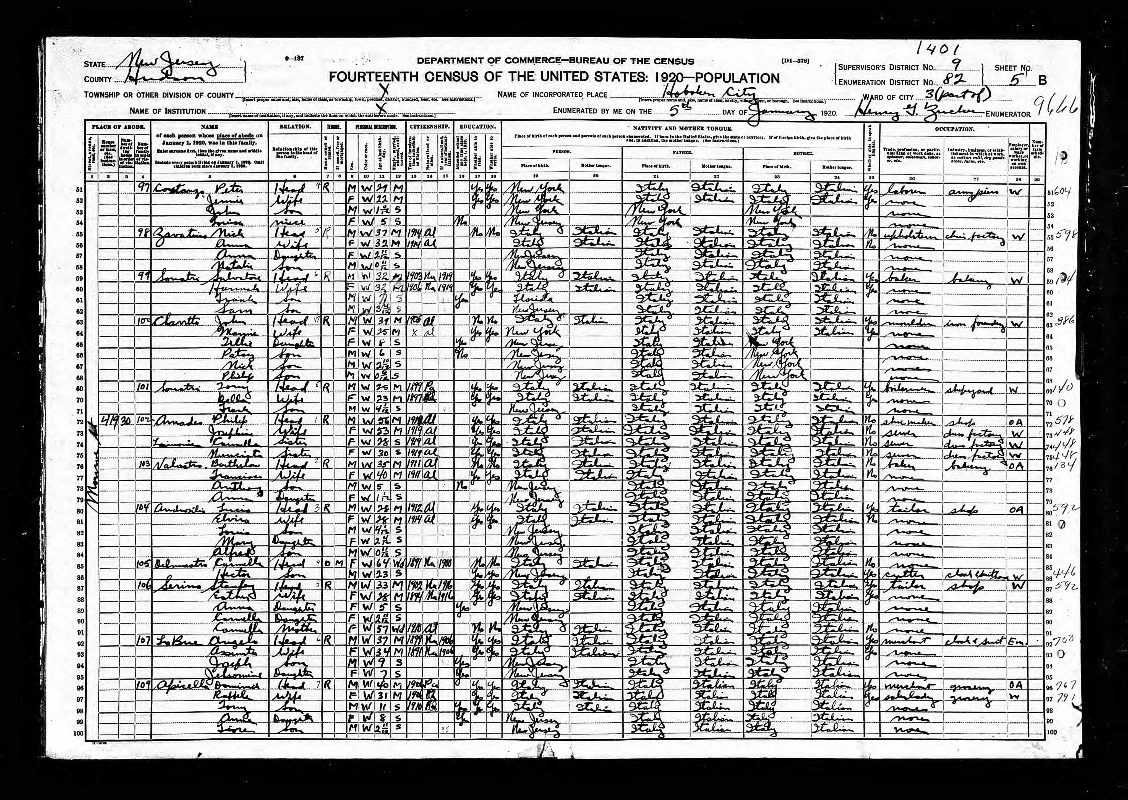

Slide 14
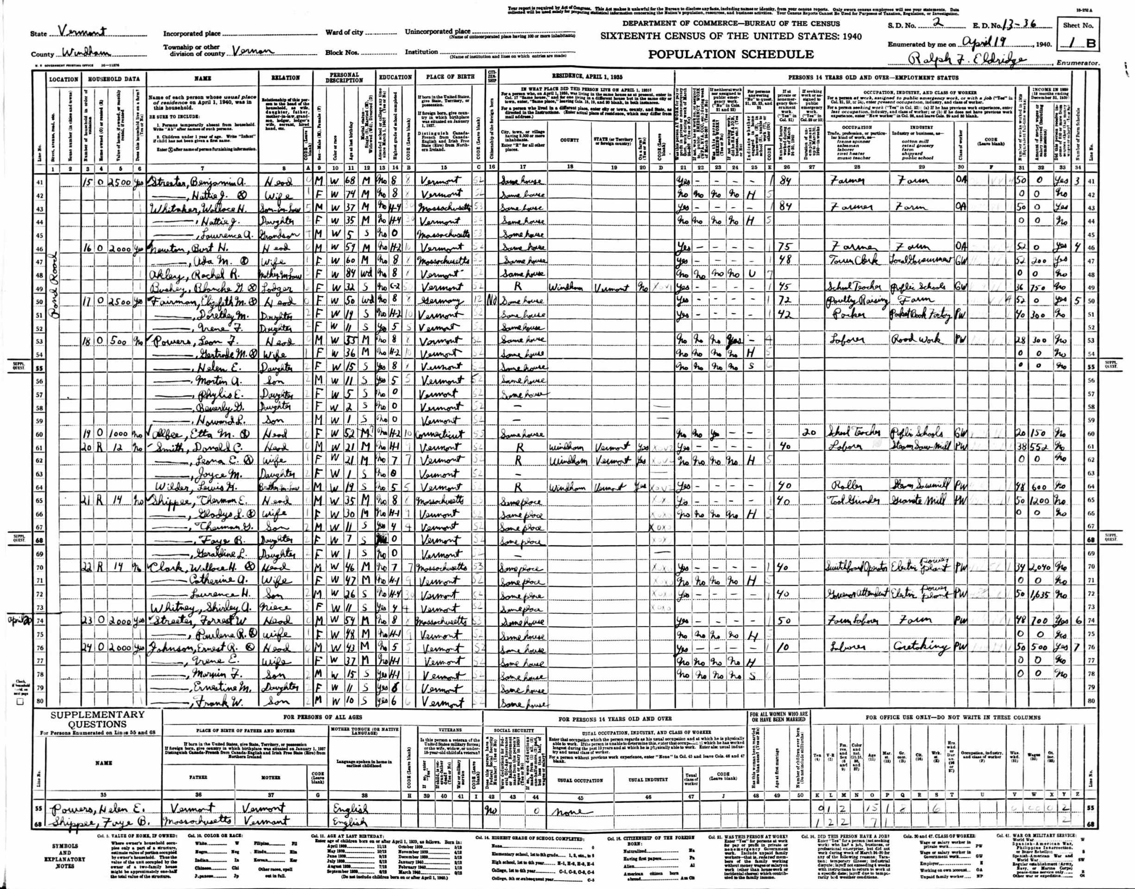

Slide 16
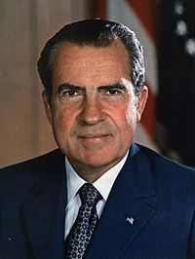
Richard Milhous Nixon
Born 1/9/1913 in Yorba Linda, CA
Died 4/22/1994 in New York, NY
Dad Francis Anthony "Frank" Nixon
Mom Hannah Milhous
Wife Thelma Catherine "Pat" Ryan (married 6/21/1940)

Slide 17
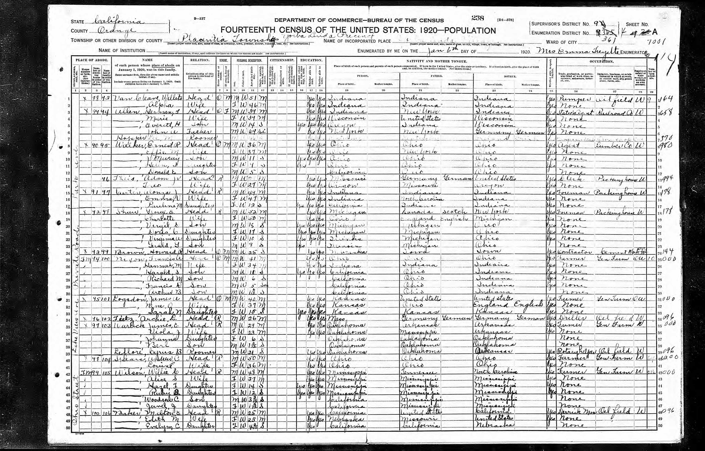

Slide 19
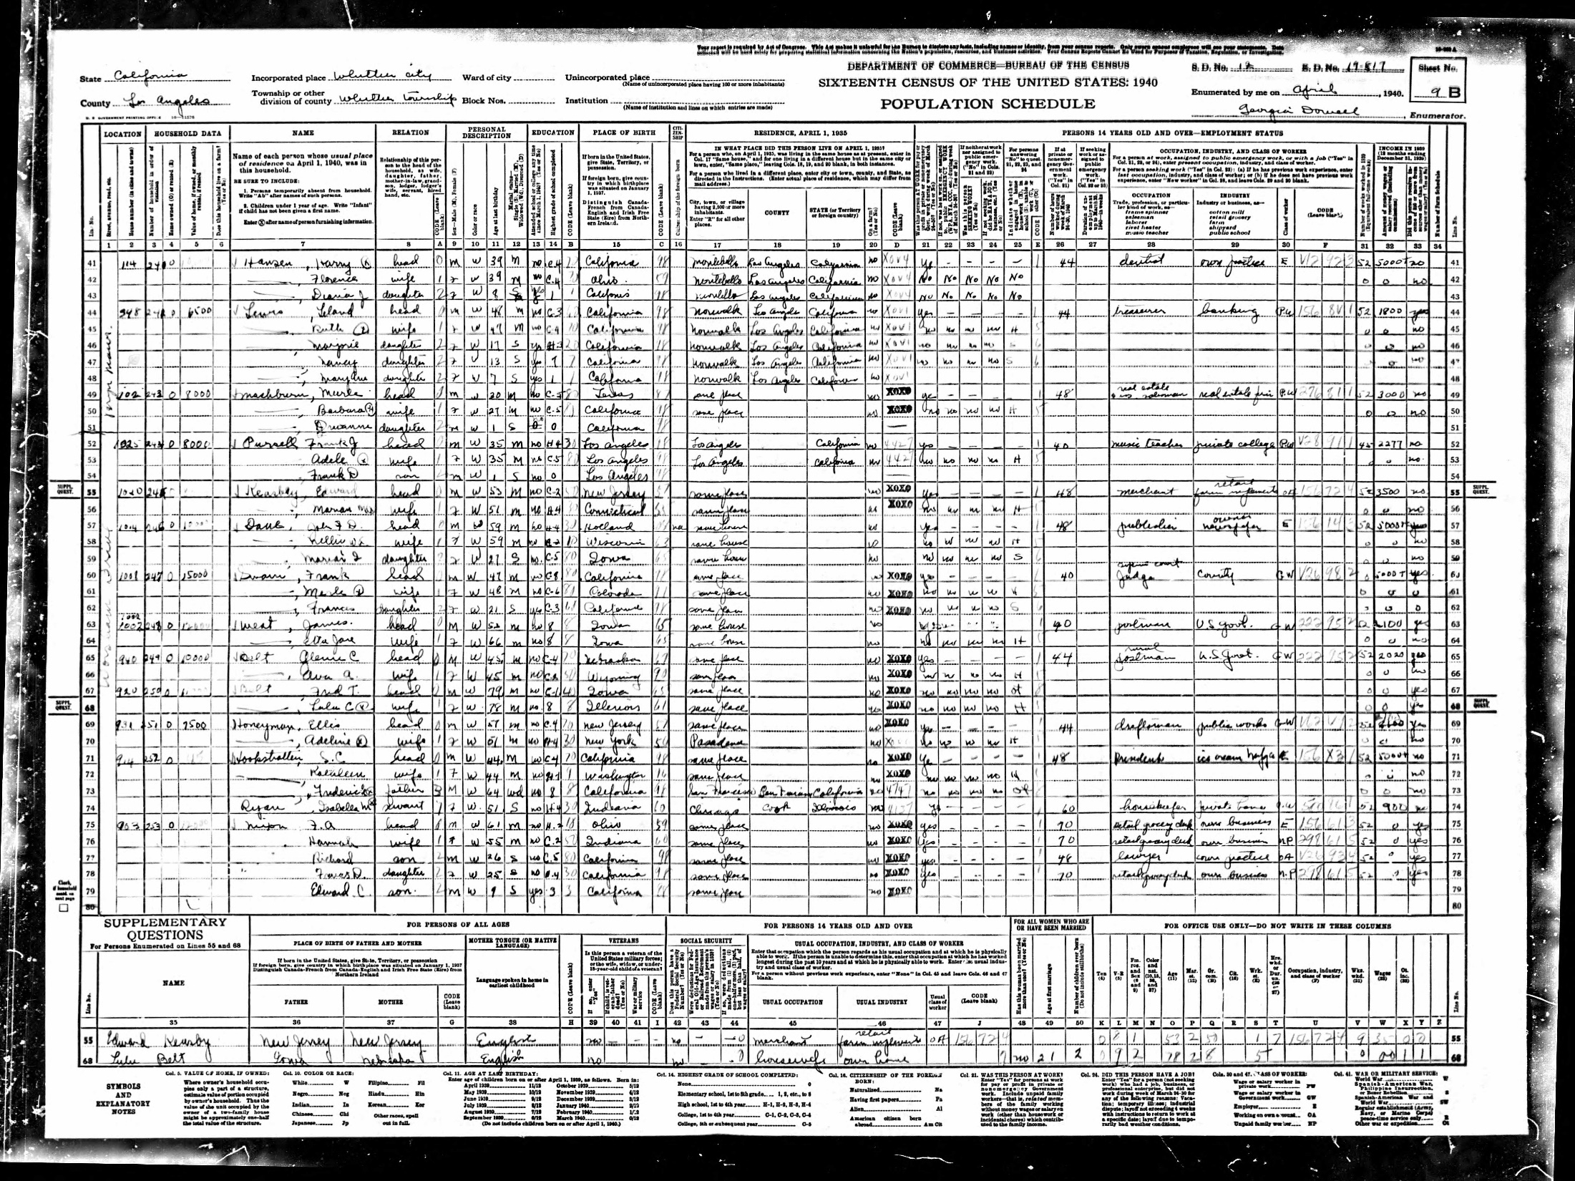

Slide 21
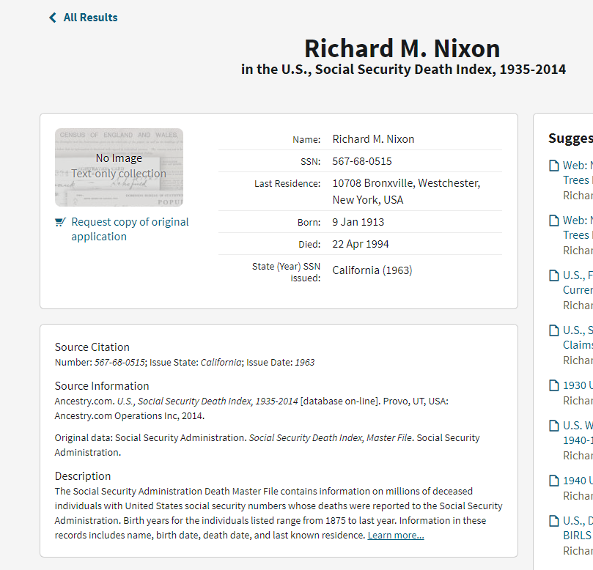

Slide 22
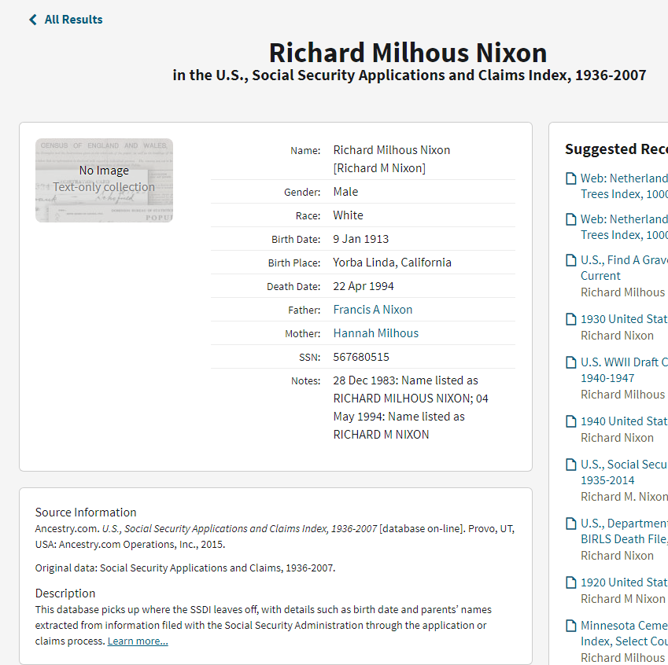

Slide 23
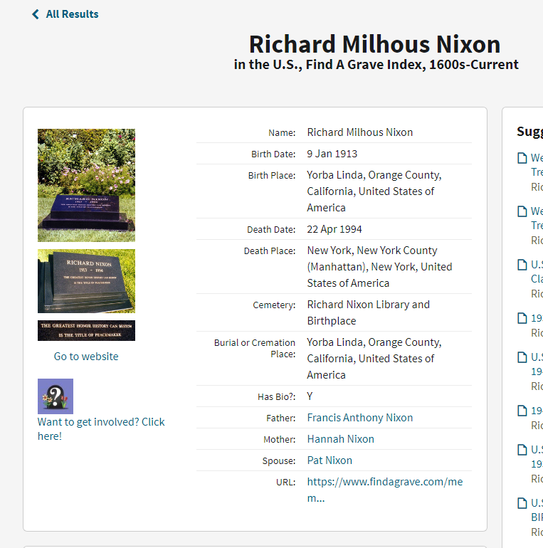

Slide 24
How Do We Get Usable Data from these Images?
Enumeration issues
Legal issues
Data entry
Data access
Record linkage

Slide 25
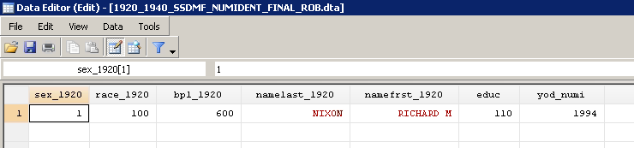

Slide 27
What Are the Effects of Discrimination on How Your Life Turns Out?
…with respect to education, occupation, income, and longevity?

Slide 28
Naïve Strategy
Ask people whether they’ve been discriminated against; see how their lives turn out
Problems?

Slide 29
Naïve Strategy
Compare people in an advantaged group to people in a disadvantaged group
Problems?

Slide 30
Unethical / Impractical Strategy
Randomly assign some people to be discriminated against, others not; see how their lives turn out
Problems?

Slide 31
Our Strategy
Compare pairs of people who are identical in almost every way … except that one is at risk of prejudice and the other is not
Across pairs … does the one who is at risk of prejudice tend to do worse than the one who is not?

Slide 32
Our Strategy
Brothers share almost everything … family, neighborhoods, schools, environmental exposures, language, culture, race, gender
Why just brothers?

Slide 33
Our Strategy
Does the brother who is at risk of prejudice tend to do worse than his brother who is not?

Slide 34
Who Is “At Risk of Prejudice?”
Proper names = a marker of group membership
Your name says a lot about your gender, race, social class, nationality, religion, and what part of the country you are from

Slide 35
Our Strategy
Does the brother with a “black name” tend to do worse than his brother who has a “white name?”

Slide 37
Percent Black, by First name
Lyle 0.3%
Michael 0.3%
Dale 0.5%
Antonio 0.7%
Wayne 0.7%
Tom 36%
Jim 39%
Johnnie 40%
Eddie 48%
Willie 53%
Note: 10% of boys were black in this cohort

Slide 39
Percent Black, by Last name
ERICKSON <0.1%
SCHMIDT <0.1%
HANSEN <0.1%
SCHWARTZ <0.1%
OLSON <0.1%
HARRIS 36%
COLEMAN 37%
WILLIAMS 39%
JACKSON 48%
WASHINGTON 93%
Note: 10% of boys were black in this cohort

Slide 40
Our Strategy
Does the brother with an “immigrant name” tend to do worse than his brother who has an “American name?”

Slide 42
Percent 3rd Generation, by First name
TONY 6%
MIKE 7%
MICHAEL 13%
ANTHONY 18%
PETER 21%
HOMER 95%
LEE 96%
CLYDE 96%
WAYNE 96%
JESSIE 96%
Note: 71% of boys were 3rd generation in this cohort

Slide 43
Our Strategy
Does the brother with a “masculine name” tend to do better than his brother who does not?

Slide 45
Common “Gender Ambiguous” First Names
JESSIE 39% Male 62,091
CLARE 42% Male 4,484
FRANKIE 50% Male 7,108
FRANCIS 54% Male 134,268
ALVA 65% Male 6,754

Slide 46
Common First Names, by Gender
MALE FEMALE
HAZEL 1,023 83,171
LOUISE 1,327 87,949
RUBY 1,403 79,337
BERNICE 1,677 53,415
PEARL 1,729 48,920
LOUIS 84,035 4,821
ELMER 56,293 1,461
JOE 64,030 1,554
EUGENE 62,567 1,448

Slide 47
Our Strategy
Does the brother with a “bible name” tend to do worse than his brother who does not?

Slide 48
Most Common Biblical & Non-Biblical Names
EDWARD 220,958
CHARLES 251,203
GEORGE 294,840
ROBERT 361,044
WILLIAM 443,483
PAUL 141,309
THOMAS 144,946
JOSEPH 294,308
JAMES 376,044
JOHN 615,930
Note: 19% of boys had biblical names in this cohort

Slide 49
Richard
99.7% male
7% black
83% third generation
Not a biblical name
29% from the north
27% from the south

