Slide 2
There are More and More College Graduates

Slide 3
Percentage of American Adults (25+)
With a 4-Year College Degree, by Year
Source: 1940-2000 US Censuses, 2001-2016 American Community Surveys

Slide 4
College Graduates Make More Money

Slide 5
Mean Wage and Salary Income, by Education
College Graduate
Cumulative Total: $2.3 million
High School Graduate
Cumulative Total: $1.0 million
Source: 2011-2016 American Community Surveys

Slide 6
College Is Expensive

Slide 7
Average Tuition and Fees and Room
and Board in 2017 Dollars
Private Non-Profit 4-Year
Public 4-Year
2-Year
SOURCES: College Board, Annual Survey of Colleges; NCES, IPEDS Fall Enrollment data.

Slide 8
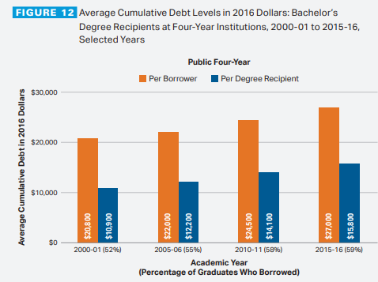

Slide 9
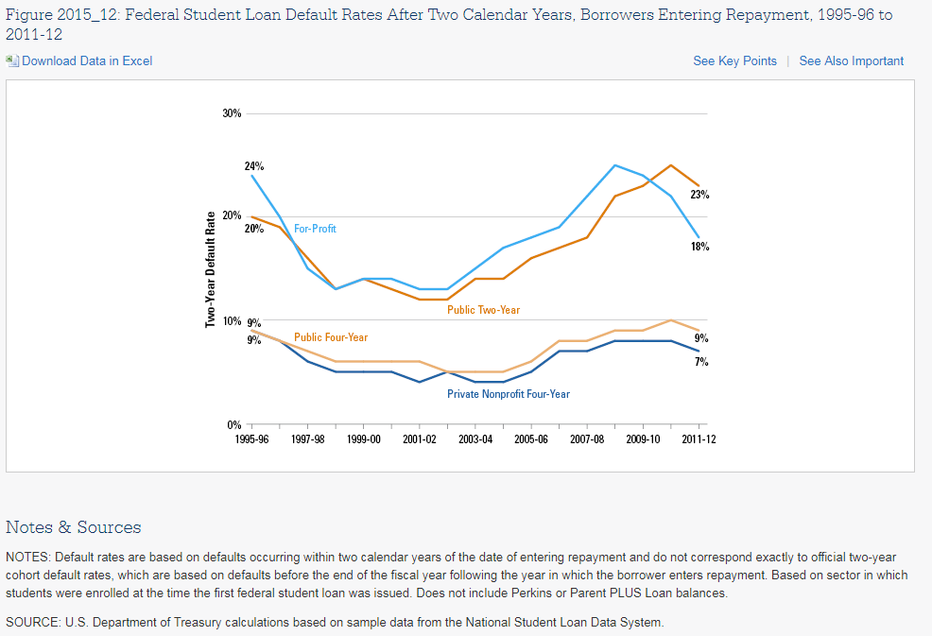

Slide 10
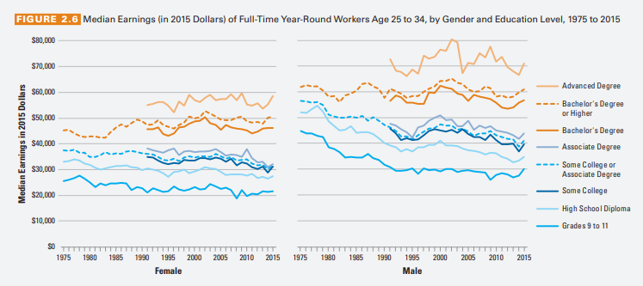

Slide 11
College Is Expensive Even if You Drop Out

Slide 12
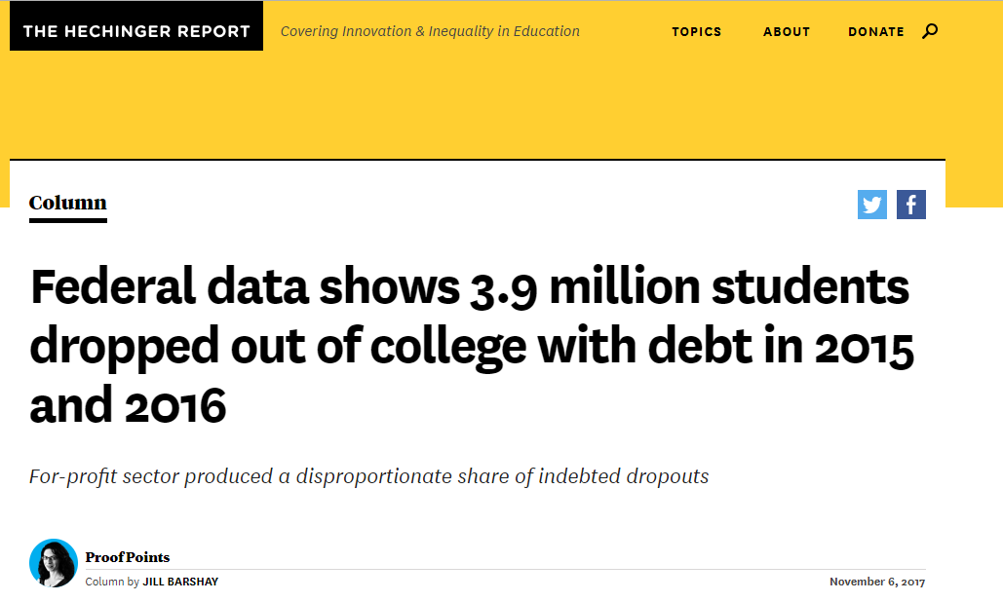

Slide 13
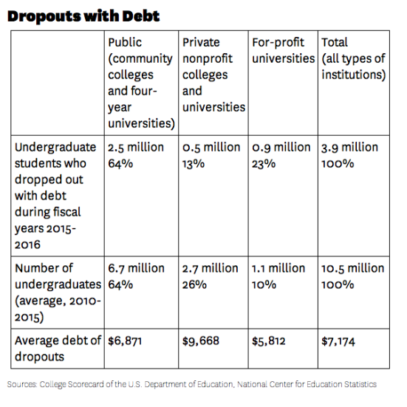

Slide 14
Two Other Facts

Slide 15
Wage and Salary Income, by Education, Ages 40-49
High School Graduates
College Graduates
Source: 2011-2016 American Community Surveys

Slide 16
Change in Percent w/ a College Degree,
by Occupation, 1980 to 2015
52 of 314 Occupations:
Now have fewer
college graduates
262 of 314 Occupations:
Now have more
college graduates
Source: 1980 Census and 2011-2016 American Community Surveys

Slide 17
Change in Percent w/ a College Degree,
by Occupation, 1980 to 2015
1980
2015
Source: 1980 Census and 2011-2016 American Community Surveys

Slide 18
Going to College is a Gamble

Slide 19
Who “Wins?”

Slide 20
Percent Graduating Within 6 Years among
1st-Time Students Starting at 4-Year Colleges in 2010
SOURCE: U.S. Department of Education, National Center for Education Statistics, Integrated Postsecondary Education Data System (IPEDS), Spring 2002 through Spring 2013 and Winter 2013-14 through Winter 2016-17, Graduation Rates component; and IPEDS Fall 2010, Institutional Characteristics component. (This table was prepared December 2017.)

Slide 21
Percent Graduating Within 6 Years among
1st-Time Students Starting at 4-Year Colleges in 2010

Slide 22
Percent Graduating Within 6 Years among
1st-Time Students Starting at 4-Year Colleges in 2010

Slide 23
More on For-Profit Colleges

Slide 27
For-profit colleges are an important and valuable part of the higher education landscape — especially for disadvantaged and non-traditional students

Slide 28
For-profit colleges are predatory, rarely deliver claimed benefits, and should be much more heavily regulated --- or maybe even closed

